Slide 1
Software Requirements Engineering
SE 311

Slide 2
Has a SW shortage ever frustrated you?

Slide 3
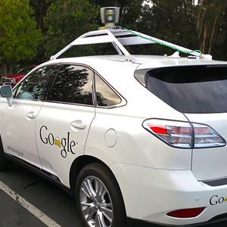
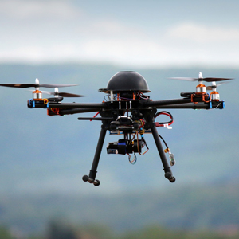

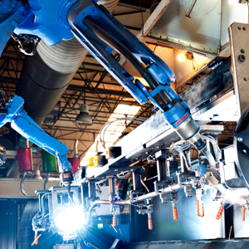
Introduction
Software defines our lives
Self-driving Vehicles
Unmanned Aerial Vehicles
Medical Sensors & Actuators
Robots
Notes:
1- Transformed the way.. Businesses operate, doctors treat their patients, wars are fought, day-to-day lives in how they gather information, communication, and use their leisure time.
Impacts are endless.
[2- available be end of this decade, could save lives by reducing traffic accidents
3- in addition to their controversial usages, drones may be used in agriculture, deliveries, including delivering medical help kits to those in emergencies much faster than an ambulance can make it.
4- can be embedded in clothing or as part of a smartphone app to monitor heart rate, calories burned, blood sugar and cholesterol. A “Wireless medicine” study that is having doctors diagnose little children’s ear infections..
5- endless applications in farms, hospitals, and factories.]
(google maps (satellites), restaurant reservations, tawakalna, ATMs and online banking)

Slide 4
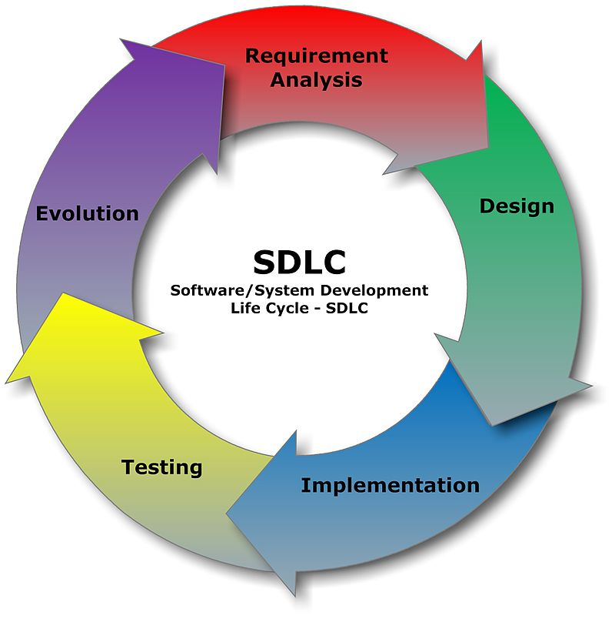
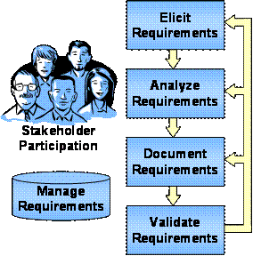
Software Development Process
Notes:
[The requirements form a complex matrix of the needs of many stakeholders who are spread across different levels of the organization and who are somehow linked to the problem. They all have different backgrounds, experiences, assumptions, expectations, and needs, which may very well conflict with each other.]

Slide 5
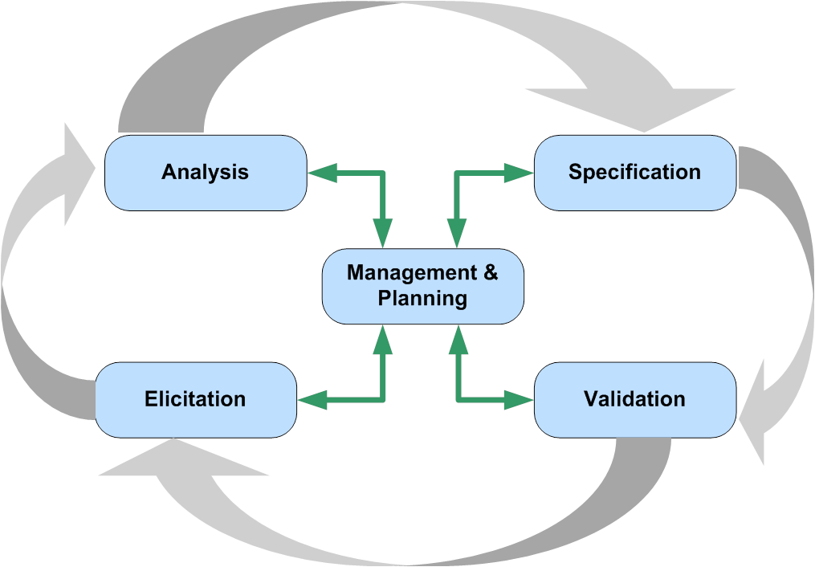
Requirements Engineering (RE) Process
A software system is assessed in terms of the extent to which it satisfies the purpose for which it was intended.
RE is the process of discovering that purpose by defining a set of software requirements to delineate the constraints and demands of the system

Slide 6
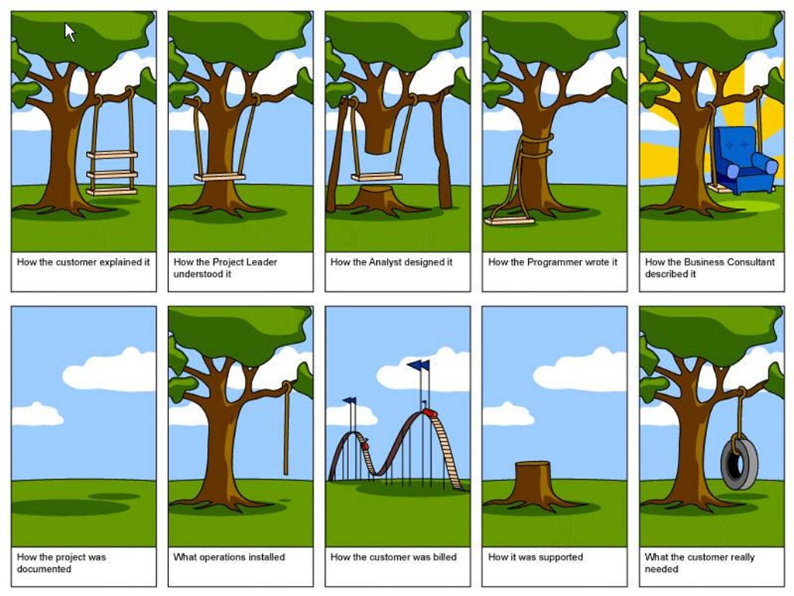
Notes:
In this scenario, the amount of discrepancies between the perspectives of project stakeholders is insane, and is extremely difficult to rectify later on in the process, which has many negative effects on projects.
If the preceding process is really implemented, then where are these complications resulting from?
[and represents a recipe for disaster that usually result in project delays, overrun, unsatisfied customers, low employee morale, defective products, or ultimately project failure]

Slide 7
Given that
The size of the worldwide software industry in 2013 was US$407.3 billion
﻿Errors introduced during requirements activities account for 40 to 50 pecrcent of all defects found in SW products
The hardest single part of conceptually defining a software system is the task of delineating the software requirements.
“no other part of the work so cripples the resulting system if done wrong” and “no other part is more difficult to rectify later” (Brooks, 1987)

Slide 8
Course Objectives
CLO1: Recognize the different types of requirements and importance of software requirement engineering.
CLO2: Identify multiple techniques to elicit requirements from stakeholders, choosing from among alternative methods as appropriate for different situations.
CLO3: Analyze documenting requirements for high-level software requirements engineering.
CLO4: Design and develop models for requirement documentation using goals, use cases, UML class and activity diagrams and state charts.
CLO5: Evaluate the software requirements using validation and negotiation techniques regarding priorities and scope with the stakeholders.
CLO6: Measure the documented requirements using quality criteria techniques for accuracy, unambiguity, consistent and completeness of the requirements.
CLO7: Demonstrate the management of requirements as they change over time. (e.g., over multiple releases and over a product line)

Slide 9
Class Project
Identify a real problem in any domain of your choice where you think a SW solution is needed to solve the problem
Identify real problem stakeholders
Conduct what you’ve learned about RE in order to capture stakeholders needs and produce a Software Requirements Specification (SRS) for your proposed solution

Slide 10
Class Project
Teams of 3-4 students
Select a team leader to coordinate communication and deliver submissions
Four deliverables:
First deliverable | Second deliverable | Third deliverable | Fourth deliverable
Vision & scope document | Elicitation notes and evidence of elicitation process A list of prioritized user requirements | SRS that is approved by stakeholders A prototype of the SW | Presentation

Slide 11
Software Requirements Fundamentals

Slide 12
Software Requirements Knowledge Area
Software Requirements
Software Requirements Fundemantals
Requirements Process
Requirements Elicitation
Requirements Analysis
Requirements Validation
Requirements Specification
Practical Consideration
Software Requirements Tools
Notes:
IEEE’s SWEBOK
Practical considerations under which requirements managments topics are discussed.

Slide 13
What is a software requirement?
A statement which translates or expresses a need and its associated constraints and conditions (IEEE/ISO/IEC 29148-2018)
At its most basic, a software requirement is a property that must be exhibited by something in order to solve some problem in the real world (SWEBOK V3)
“Requirements are a specification of what should be implemented. They are descriptions of how the system should behave, or of a system property or attribute. They may be a constraint on the development process of the system” (Sommerville & Sawyer, 1997)

Slide 14
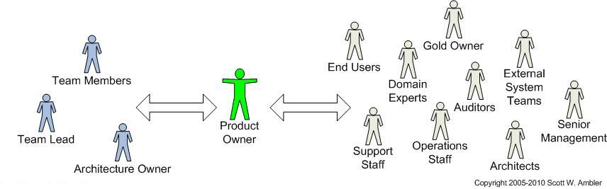
What are software requirements?
The set of requirements form a complex matrix of the needs of many stakeholders who are spread across different levels of the organization and who are somehow linked to the problem

Slide 15
Types of Requirements

Slide 16
Software Requirements
Business Requirements
User Requirements
Functional Requirements
System Requirements
Non-functional Requirements
Definitions
﻿Describe why the organization is implementing the system.
Describe goals or tasks the users must be able to perform with the product that will provide value to someone.
Specify the behaviors the product will exhibit under specific conditions
Describe the requirements for a product that is composed of multiple components or subsystems
Describe how well the products carries out its tasks.
Quality attributes
Constraints
External interface
Notes:
﻿Functional requirements: They describe what the developers must implement to enable users to accomplish their tasks (user requirements), thereby satisfying the business requirements.. They’re documented in a software requirements specification (SRS),
﻿System requirements. ﻿A system can be all software or it can include both software and hardware subsystems.
﻿Non-functional requirements ﻿might specify not what the system does, but rather how well it does those things.

Slide 17
Software Requirements
Business Requirements
User Requirements
Functional Requirements
System Requirements
Non-functional Requirements
Examples
﻿”Airline wants to reduce airport counter staff costs by 25 percent.“
﻿﻿”User needs to be able to check-in for flight using airline’s website.”
﻿﻿”If the Passenger’s profile does not indicate a seating preference, the reservation system shall assign a seat.”
﻿﻿”The airport check-in kiosks need a barcode reader to scan a passport OR the app needs to be iOS compatible.”
﻿﻿”The airline’s website needs to be available 98% of the time.”

Slide 18
Software Requirements
Business Requirements
User Requirements
Functional Requirements
System Requirements
Non-functional Requirements
Definitions
﻿Describe why the organization is implementing the system.
Describe goals or tasks the users must be able to perform with the product that will provide value to someone.
Specify the behaviors the product will exhibit under specific conditions
Describe the requirements for a product that is composed of multiple components or subsystems
Describe how well the products carries out its tasks.
Quality attributes
External interfaces
Constraints
Examples
﻿”Airline wants to reduce airport counter staff costs by 25 percent.“
﻿﻿”User needs to be able to check-in for flight using airline’s website.”
﻿﻿”If the Passenger’s profile does not indicate a seating preference, the reservation system shall assign a seat.”
﻿﻿”The airport check-in kiosks need a barcode reader to scan a passport.”
﻿﻿”The airline’s website needs to be available 98% of the time OR the app needs to be iOS compatible.”
Notes:
Functional requirements: They describe what the developers must implement to enable users to accomplish their tasks (user requirements), thereby satisfying the business requirements. They’re documented in a software requirements specification (SRS),
﻿
System requirements. ﻿A system can be all software or it can include both software and hardware subsystems.
﻿
Non-functional requirements ﻿might specify not what the system does, but rather how well it does those things.

Slide 19
Non-functional Requirements
(Also called quality of service requirements, quality factors, and the “-ilities”)
Quality Attributes
External Interfaces
Constraints
Definitions
Describe the product’s characteristics in various dimensions that are important either to users or to developers and maintainers (performance, safety, availability, compatibility, …etc.)
Describe the connections between the system and the outside world (other SW, HW, users, communication interfaces).
Impose restrictions on the options available to the developer during construction of the product (development process, documentation, programming language, cost and delivery …etc.)
Examples
“The flight search results should load within 5 seconds after the user hits the “Search” button”.
“A link to the Tawakkalna system database needs to be established to verify the COVID-19 status of a passenger using his national ID number”.
“The system development process and deliverable documents shall conform to the process and deliverables defined in MIL-STD-498”.
Notes:
Some people consider non-functional requirements to be synonymous with quality attributes, but this is overly restrictive.
E.g. Usability, reliability, reusability, maintainability.

Slide 20
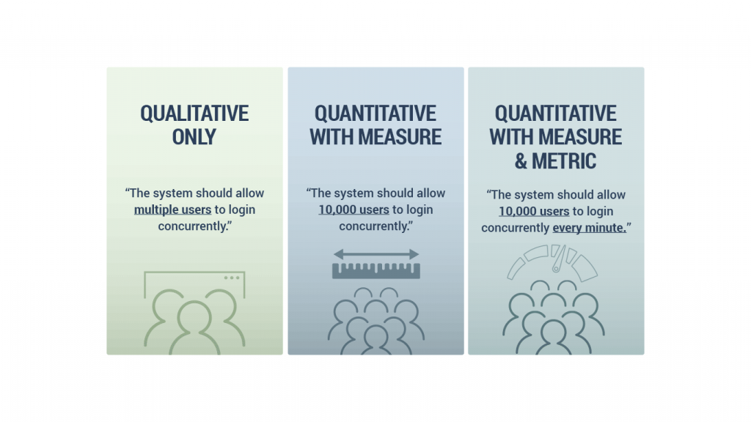
Expression of Non-functional Requirements

Slide 21
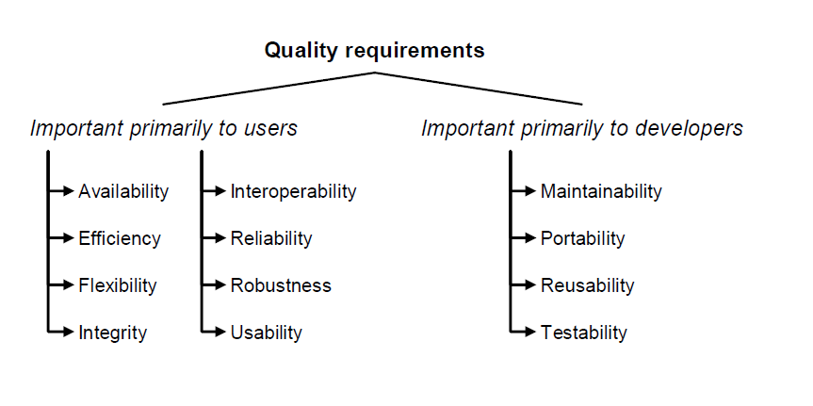
Notes:
*Portability when you move the system from one operating system windows 7 to windows 10
Reliability giving the same output
Robustness the ability of the system to deal with error

Slide 22
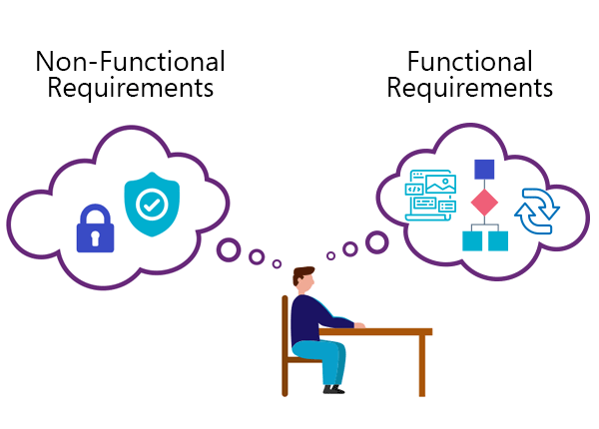
Product properties
How should the system do?
Helps verify performance.
More difficult to capture.
Product features
What should the system do?
Helps verify functionality.
Easier to capture.
VS.
“When sending welcome emails, the server must send them within 10 minutes of registration”.
“When packing slips are printed, they must be on both sides of 5” x 8” sheets of white paper”.
“When a site visitor creates an account, the server shall send a welcome email”.
“When order status changes to fulfillment, the local printer shall print a packing slip”.

Slide 23
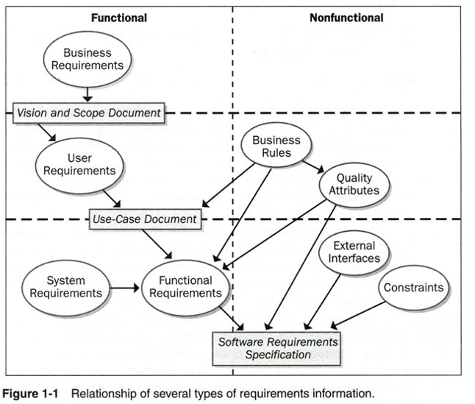
Notes:
﻿The ovals represent types of requirements information, and the rectangles indicate documents in which to store that information.
Business rules include corporate policies, government regulations, industry standards, and computational algorithms.
Requirements deliverables: Vision and scope document, user requirements document, and SRS.
﻿Figure shows simple top-down flow of requirements information. In reality, you should expect cycles and iteration among the business, user, and functional requirements. Whenever someone proposes a new feature, user requirement, or bit of functionality, the analyst must ask, “Is this in scope?”

Slide 24
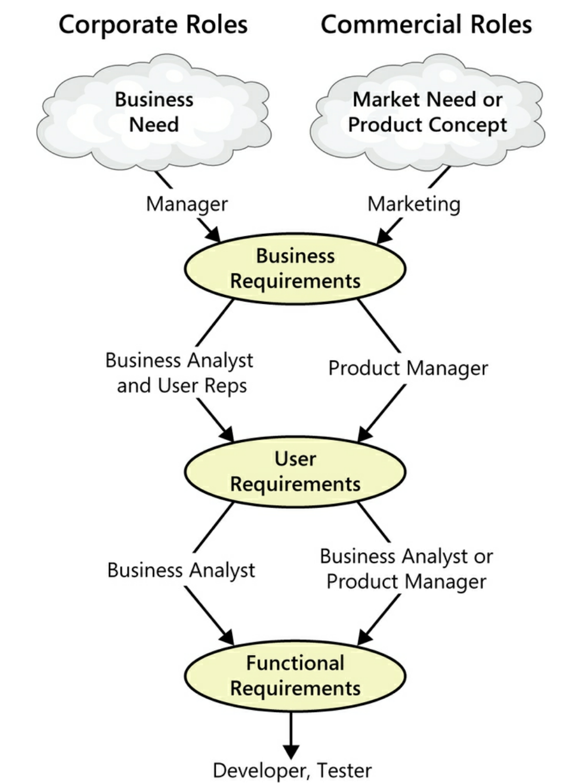
Notes:
The textbook classifies requirements into these 3 main categories, but acknowledges the rest.

Slide 25
Domain Requirements
Derived from application domain
Describe system characteristics and features that reflect the domain
May be new functional requirements or constraints on existing requirements
Example: “A patient’s designated physician is the only entity allowed to retrieve a patient’s medical reports”.
Notes:
You may also hear of the term “Domain requirements”
The application domain reflects the environment in which the system operates such as governmental, medical, e-commerce, …etc.
These may intersect with Business Rules
Domain requirements may be expressed using specialized domain terminology or reference to domain concepts

Slide 26
Why RE?

Slide 27
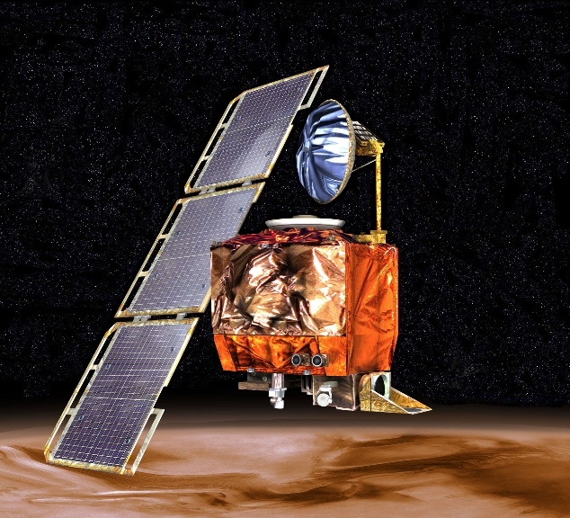
Mars Climate Orbiter
Cost about $235.9M
Launched by NASA in 1998 to study the Martian climate.
It disappeared around Mars in 1999
Failure caused by a measurement mismatch between two SW systems: the NASA team used the metric system, while the spacecraft builder Lockheed Martin used the English system for a key function
Notes:
Permanently lost communication with the orbiter
The spacecraft encountered Mars on a trajectory that brought it too close to the planet, and it was either destroyed in the atmosphere or escaped the planet's vicinity and entered an orbit around the Sun
Mile second , feet second

Slide 28
Integrated Resource Management Project (GIRES)
GIRES (Gestion intégrée des ressources)
To replace >1000 existing systems in 140 organisations / departments
Affecting 68,000 employees
The project started in 1998 with an estimated timeframe of 8 years and a budget of $80 million
Could not cope with changes to the requirements and was cancelled in 2003 after investing
Total cost: $400 million

Slide 29
Why Focus on RE?
Code
7%
Code
1%
Other
4%
Requirements
56%
Other
10%
Design
13%
Requirements
82%
Design
27%
Distribution of Defects
Distribution of Effort to Fix Defects

Slide 30
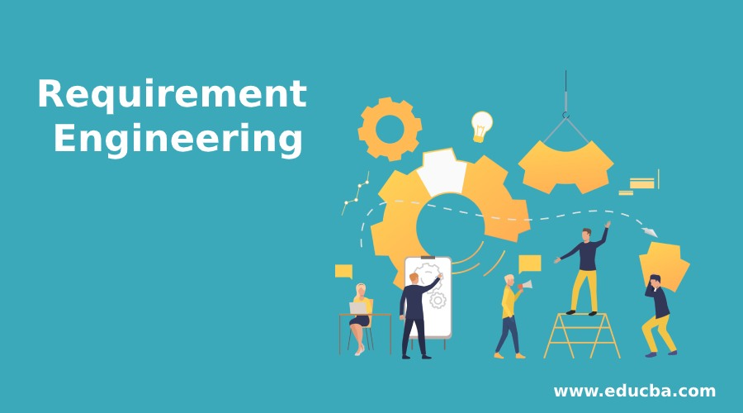
Definition of RE
“The branch of software engineering concerned with the real-world goals for functions of and constraints on software systems. It is also concerned with the relationship of these factors to precise specifications of software behavior, and to their evolution over time and across software families” (Zave, 1997)

Slide 31
Definition of RE
Encompasses all the activities involved in determining, documenting, and managing stakeholder requirements, which are to be met by a new or evolving system
Is concerned with identifying the purpose of a SW system and the context in which it will be used
Starts with real-world needs of stakeholders and translates them into a set of requirements artifacts to be implemented into a SW system
Notes:
Forms a bridge between customer needs and construction of sought out products
If anything is lost during this translation process

Slide 32
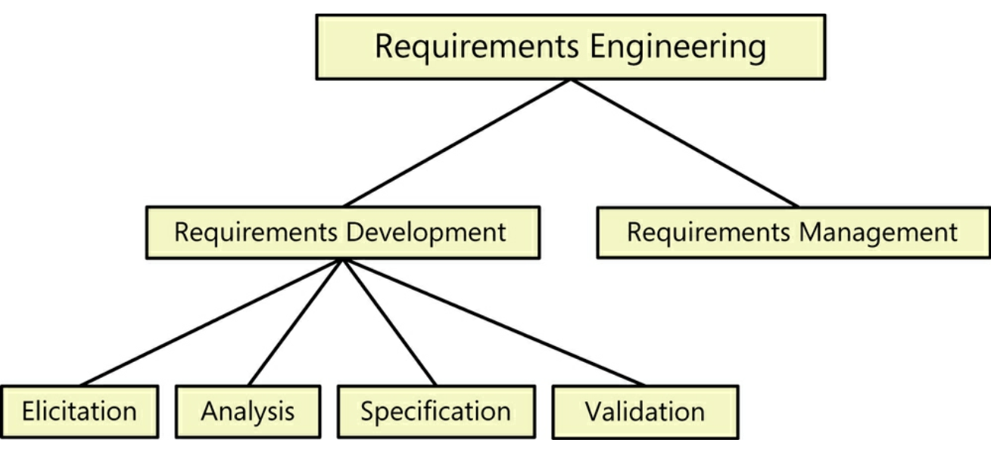
RE Activities
Requirements Inception
Notes:
Inceoption: Start the process (business need, market opportunity, great idea), business case, feasibility study, system scope, risks, etc.
Elicitation: All the tasks involved with discovering and gathering the requirements (interviews, document analysis)
Analysis: Develop a deep understating of the requirements on an individual level and as a whole (decomposition, conflicts, gaps)
Specification: Documenting these requirements in a well-organized way suitable for comprehension by their intended audiences.
Validation: Reviewing the documented requirements by internal teams and the customer to confirm that it’s complete and properly represented and that it meets the customer needs.
Management: Managing the requirements beyond being agreed upon and through implementation up until the project is completed (tracing reqs, tracking status, changes – scope, assessing impact, accepting or refusing)
Regardless of what development life cycle is being used (waterfall, iterative, agile, …etc.) these are the thing you need to do regarding requirements.
Iteration is key to requirements development success.

Slide 33
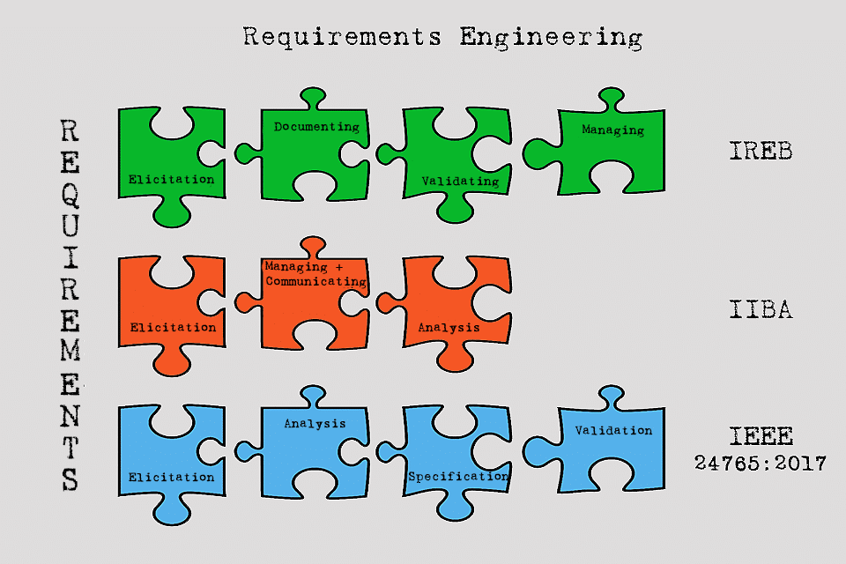
Notes:
All the activities we will go over are encompassed in one area or the other – in other words, there’s consensus on what needs to be done, but different views of how the tasks are organized or classified
IREB = International Requirements Engineering Board – Germany
IIBA = International Institute of Business Analysis – Canada
IEEE = Institute of Electrical and Electronics Engineers - USA

Slide 34
RE Challenges
Lack of the right expertise
Insufficient user involvement
Overlooked stakeholders
Unrealistic or unclear goals
Ambiguous requirements
Conflicting requirements
Creeping user requirements
Changing requirements
Notes:
Business analysts, SW engineers, domain experts
Shortage in user involvement could come from both sides – stakeholders reluctant to give time or unavailable or SW team don’t involve users enough

Slide 35
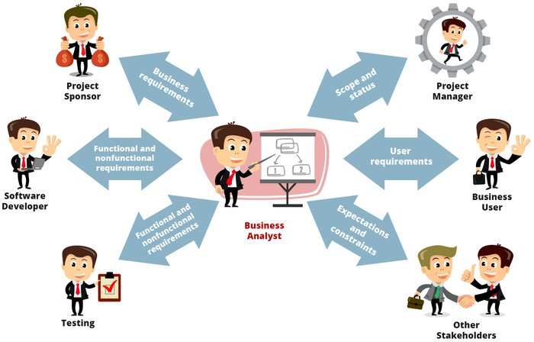
The Business Analyst (BA)
﻿The individual who has the primary responsibility to elicit, analyze, document, and validate the needs of the project stakeholders.
Notes:
Serves as the main interpreter between the customer community and the software development team
﻿requirements analyst, systems analyst, requirements engineer, requirements manager, application analyst, IT business analyst, and simply analyst.

Slide 36
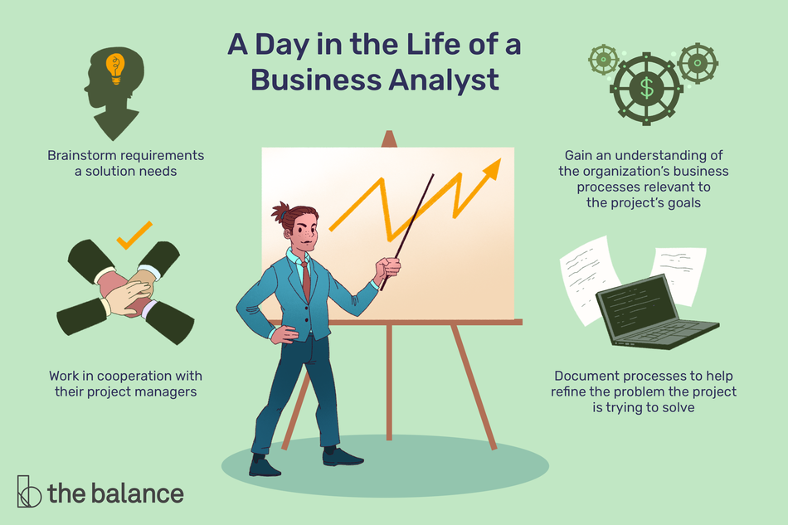
The BA’s Tasks
Define project scope and business requirements
Plan the requirements approach
Identify stakeholders
Elicit requirements
Analyze requirements
Document requriements
Validate requirements
Manage requirements

Slide 37
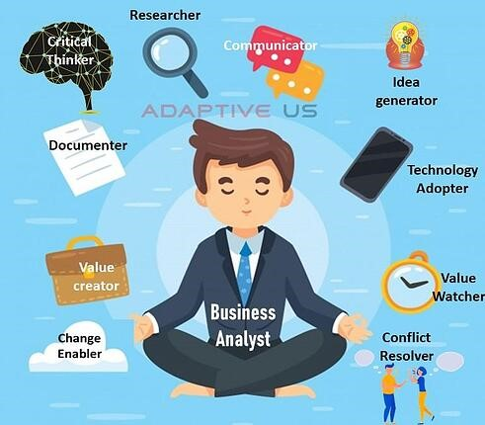
The BA’s Skill Set
BA
Listening
Interviewing
Facilitation
Observational
Learning
Analytical
Communication
Interpersonal
Notes:
A trap that a lot of people fall into is to assume that any developer can automatically be an effective business analyst.
Active listening by maintiaining eye contact and echoing key point to confirm understaning
Interviewing diverse groups about their needs
﻿Facilitation is the act of leading a group towards success. Facilitation is essential when collaboratively defining requirements, prioritizing needs, and resolving conflicts.
Observational: these come in handy when requirements are gathered through user observation on the job, be able to detect point user doesn’t mention.
﻿Learning: application or industry domain, processes, documents
Analytical: are important when trying to convert user requirements in functional and non-functional, breaking down complex requirements
Communication: ﻿﻿ability to express complex ideas clearly, both in written form and verbally.
Interpersonal: get people with competing interests to work together as a team, ﻿speak the language of the audience she is talking to, not using technical jargon, deal with resisting stakeholders.

Slide 38
Requirements Engineering (RE) Process
A process is a sequence of steps performed for a given purpose (e.g. SW development process)
RE is a process, not a discrete activity

Slide 39
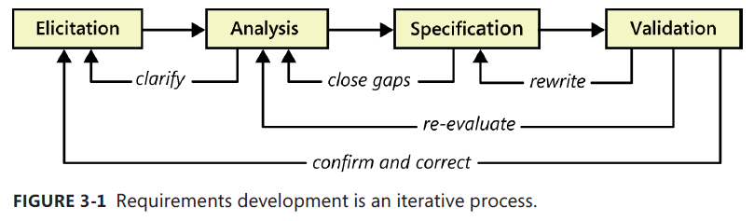
RE Process
Requirements Development
Inception
Management
Requirements Management
Notes:
Inception: define scope and context (stakeholders, plans)
Elicitation: gathering requirements
Analysis: analyzing them individually and as a whole to identify conflicts, gaps, missing information.
Specification: Documenting the requirements gradually in order to build the SRS.
Validation: Making sure the documented requirements are complete, consistent, and reflect what the customer needs
Management: Managing the baselined requirements through implementation and until project is completed (change requests, scope creep, tracing, tracking status)

Slide 40
Requirements Development Process
Inception
“Progressive refinement of detail”
Notes:
Inception is only done once at the start of the project.
This is an iterative process – in other words, these activities are not performed in a simple linear sequence, but rather are interwoven and iterative.
Important operating phrase: moving from initial concepts of what is needed towards further precision of understanding and expression.
﻿You’re never going to get perfect requirements. Practically speaking, the goal of requirements development is to create a shared understanding of requirements that is good enough to allow construction of the product.

Slide 41
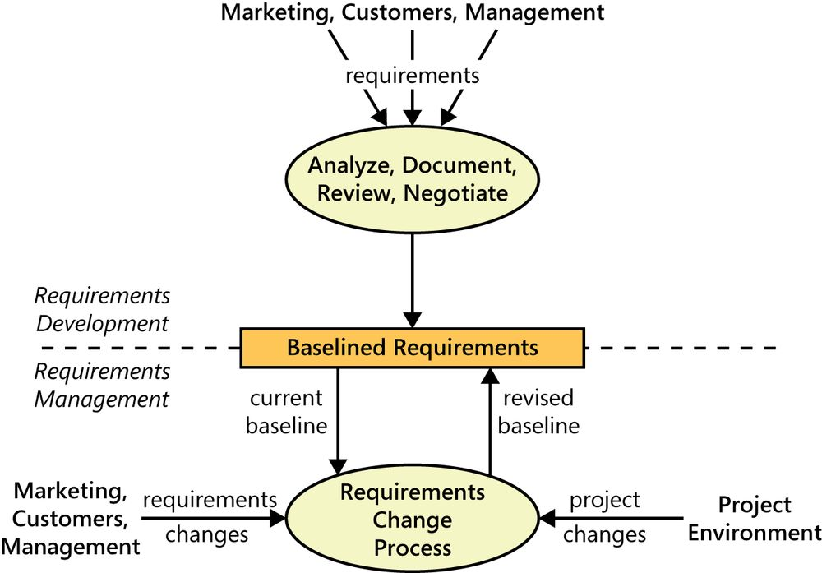
Boundary Between RD and RM
Notes:
Instances of requirements change could potentially initiate a new cycle of requirements development, depending on the scale of change.
Not following a proper change management process (e.g. implementing changes directly without amending documentation) can have severe consequences on the final product and its maintenance.

Slide 42
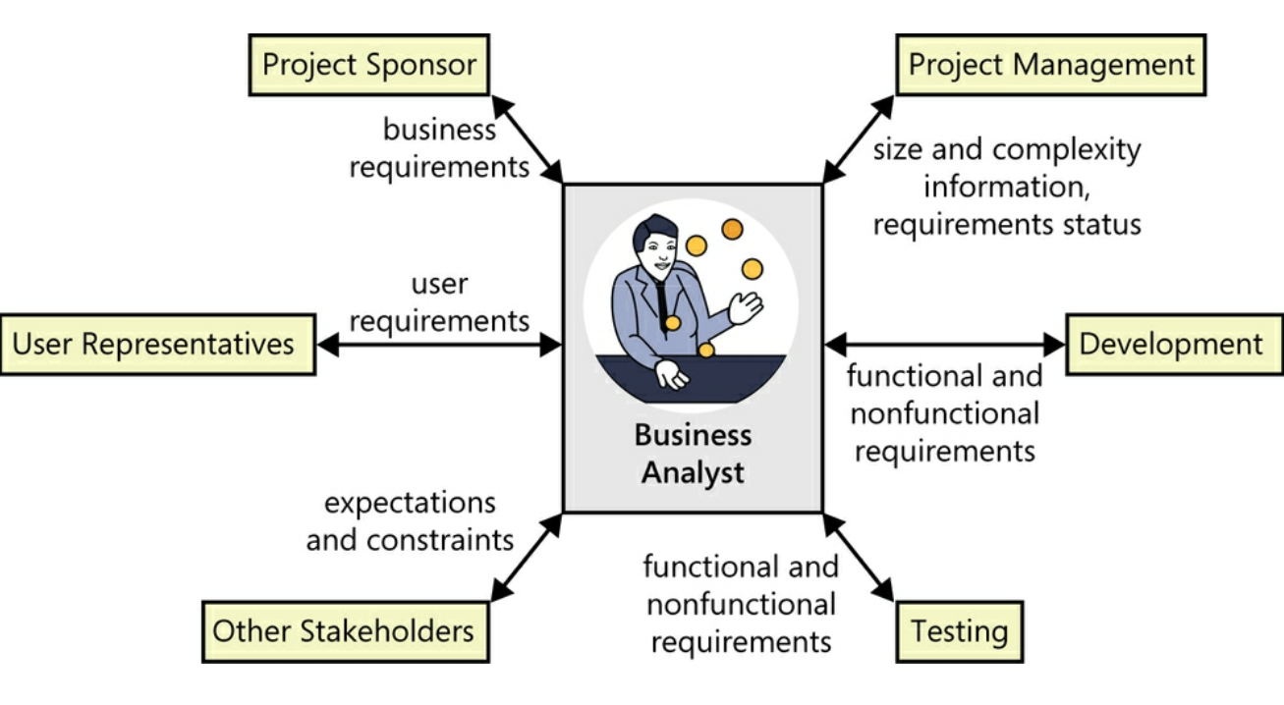
RE Process Stakeholders

